Slide 1



London Enterprise Adviser Network
EA CPD - How to plan an activity
Tuesday 23rd February 2021
@CareersHubEast @Local_London1 @CareerEnt

Slide 2

Agenda
Gatsby Benchmark 5&6 online guidance
Good practice for virtual meetings
Activity format cycle
GB5 &6 Activity planning sheet (template & practice)
Activity planning tips & examples
Q&A
Networking

Slide 3

Meeting the Gatsby Benchmark 5

Slide 4
What can employers do to support this benchmark?
Employers can deliver a range of activities enabling young people to learn about the workplace, including activities online.
Encounters should allow students to learn about work, employment and the skills that are valued in the workplace. Ideally, individual activities will sit within a progressive careers programme that supports positive student outcomes.
Even if you have limited resources, a short well-planned activity can have an impact.
You can work with your HR team to promote encounters as a valuable volunteering and staff development opportunity and a way to contribute to economic recovery.

Slide 5
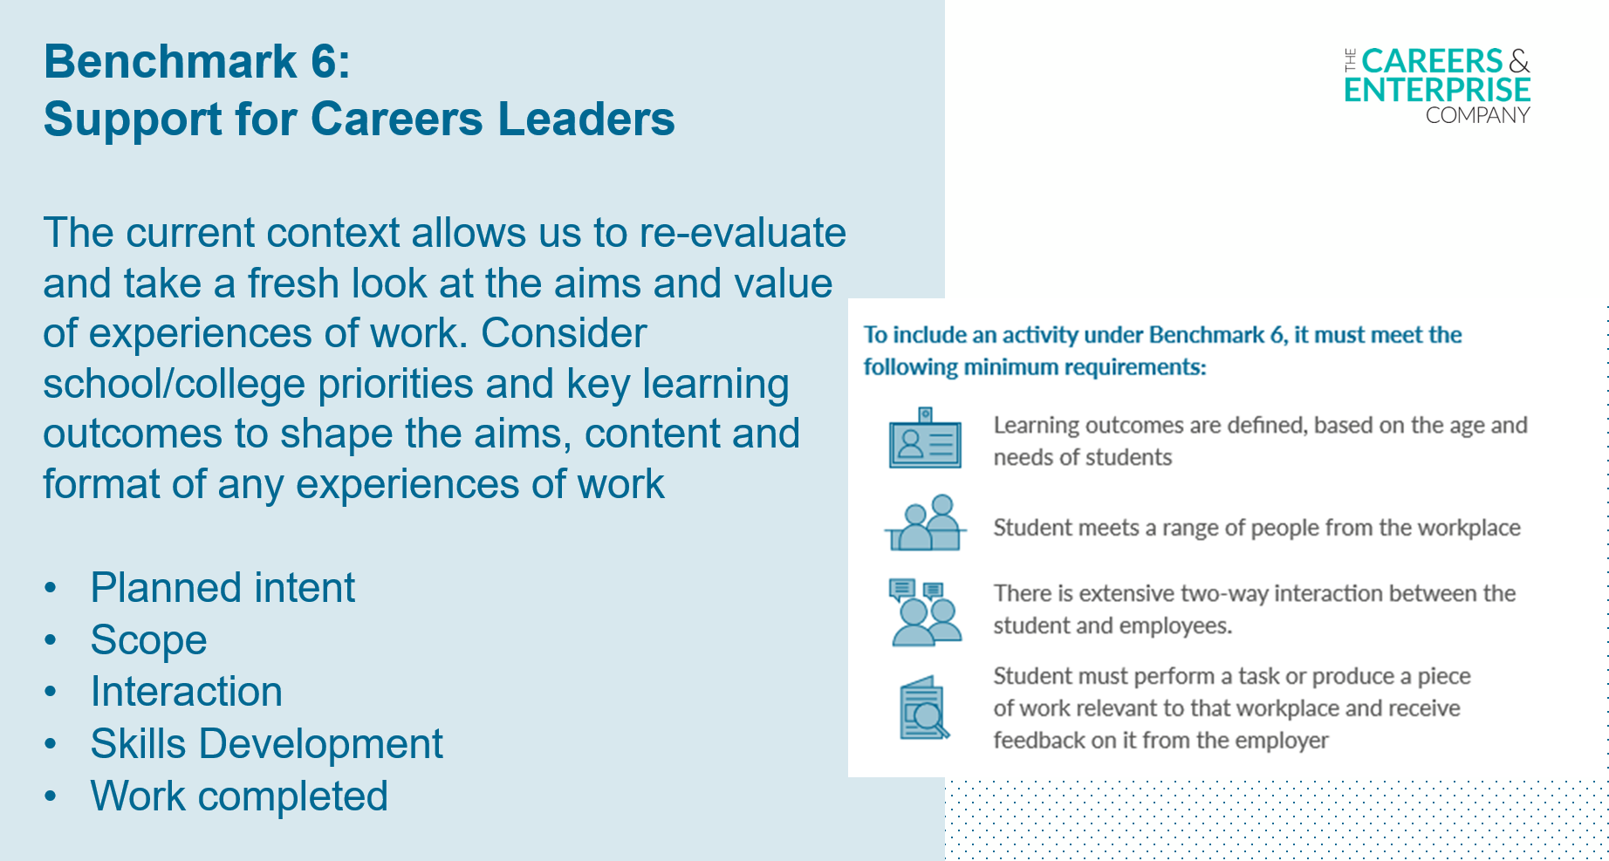
Meeting the Gatsby Benchmark 6
Notes:
All experiences of workplaces should sit within a progressive careers programme that have clear learning outcomes and that supports positive student outcomes.
Across the country, Careers Leaders and employers have responded creatively, adapting their careers programmes to the new environment so that young people can be inspired and prepared for the world of work.

Slide 6
What can employers do to support this benchmark?
Experiences of workplaces should allow students to have firsthand experiences of the workplace through online or face-to-face work visits, work shadowing and/or work experience to help their exploration of career opportunities and expand their networks. Experiences of the workplaces should reflect the fast-changing nature of work, including remote application processes and working.
Many employers have embraced digital platforms in lockdown and converted face-to-face workplace experiences to take place online.
These online experiences should still maintain high levels of interaction in order to be as impactful as possible.
Take this opportunity to consider how existing work experience programmes can be adapted to a virtual or blended scenario.
By utilising the technology that has allowed your teams to collaborate and be productive while working remotely and providing real-life insights from across the company, you can create a meaningful and impactful experience of your workplace.
Just ensure that the students perform a task or produce a piece of work that is relevant to your workplace!

Slide 7
Ensuring quality and impact when delivering virtually
Make sure the activity involves two-way interaction between students and employers/employees/self-employed.
Help the school in recording feedback during or at the end of the activity by providing evidence that the students actively participated (eg. quiz, poll, show of hands etc.)
Consider the technology required for inclusive participation and ways that barriers to participation can be overcome.
Consider the structure and length of each section of the experience compared to your usual face-to-face activities.

Slide 8
Good practice for virtual meetings
• Webinars and recordings are recommended where possible as opposed to live delivery interaction
• All staff and young people must wear suitable clothing, including anyone else in the household
• Any computers used should be in appropriate areas, for example, not in bedrooms. Consider the background that the young person will see on video.
• If communicating with students online, make sure the platform you are using is suitable for their age group. Also check the privacy settings.
• Sessions should be kept to a reasonable time
• Language must be professional and appropriate, including that of any family members in the background
Notes:
https://www.thecdi.net/write/CDI-Position-Paper_on_safe_and_ethical_virtual_meetings.pdf

Slide 9

Planning - activity format cycle
Define what students will learn (Learning Objectives)
Make links between careers and the curriculum (Maths, English, Science)
Identify how you will measure success (Evaluation)
Guest speaker – please ensure they have the link and they are aware of their time slot and have been briefed on safeguarding
Have a activity plan (see template)
Ensure the careers activity provides impartial information and is engaging for all
If possible do a ‘dry run’ with anyone beforehand (EA, EC, colleague, friend)
Is there an information pack that would need to be sent to teacher or students in advance? Please allow sufficient time for action.
What tech will schools need (audio, camera on/off, chat box), Ms Teams or Zoom etc. ?

Slide 10

Delivery on the day - activity format cycle
Log on 15 minutes beforehand to make sure there are no tech issues
Have any slides, resources, sound ready
Housekeeping rules
Clearly state the Learning Objectives of the activity and expectations from students
Gather evidence to inform the evaluation from all participants/
Collect feedback on the day
Tips:
Don’t be nervous, the teacher is there to manage the students
A member of staff will be there to support with any issues
Remember the students are more shy or nervous than you.
Don’t record or screenshot anything! Safeguarding!!

Slide 11

Reflection - activity format cycle
Build an evidence base to inform future activity
Debrief session – TBC with your EC and CL
Record and review feedback from all participants to inform continuous improvement
Reinforce the learning
Students are encouraged to reflect on each encounter
Build reflection time into your activity

Slide 12

Next steps
What Comes Next?
Share best practice and learn from others
Create a good news story /case study to share with LEANEast (newsletter, social media, across the network)
Inspire and engage
Celebrate and inspire a culture of where everyone has responsibility for careers learning across the school and the community
Promote awareness of careers events externally using multi media channels
Social media handles: @LEANEASTLondon, @CareerEnt, @Local_London1
Get permission from schools to name and tag them
Safeguarding note: please do not screenshot or printscreen during delivery; if a school provides you with a picture from the virtual event please ensure is stated you are allowed to share it online or with your company

Slide 13
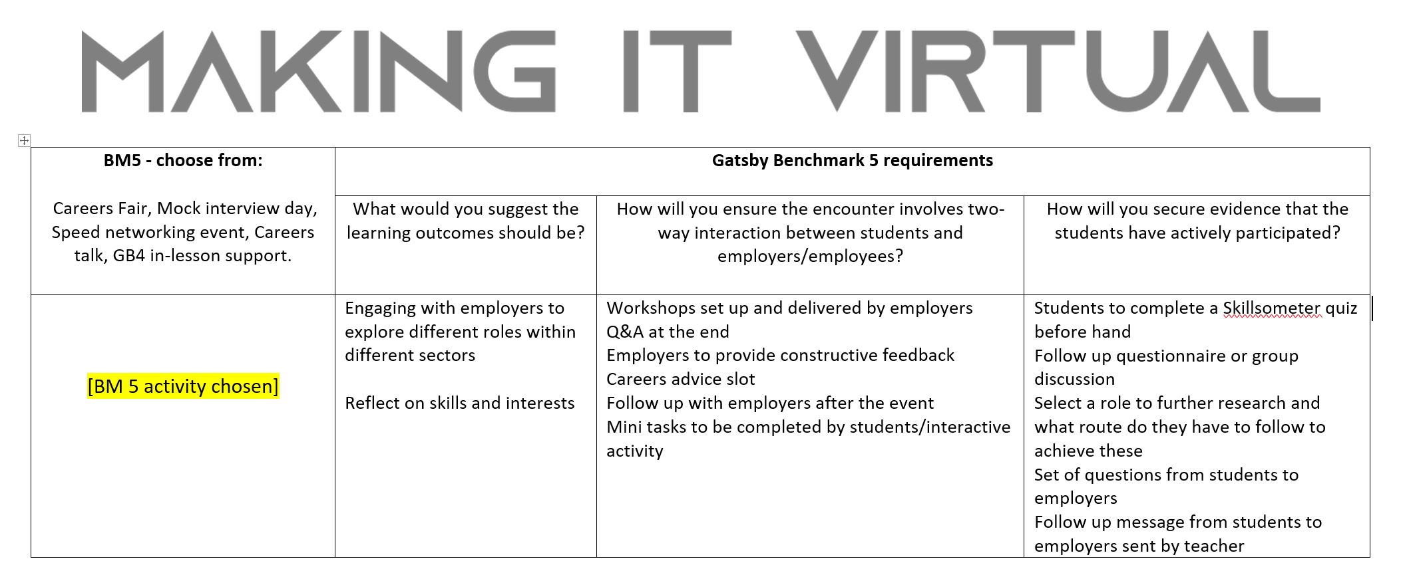
Activity planning sheet (template)
Notes:
https://www.careersandenterprise.co.uk/sites/default/files/uploaded/1207_-_meaningful_encounters_checklist_1.pdf

Slide 14
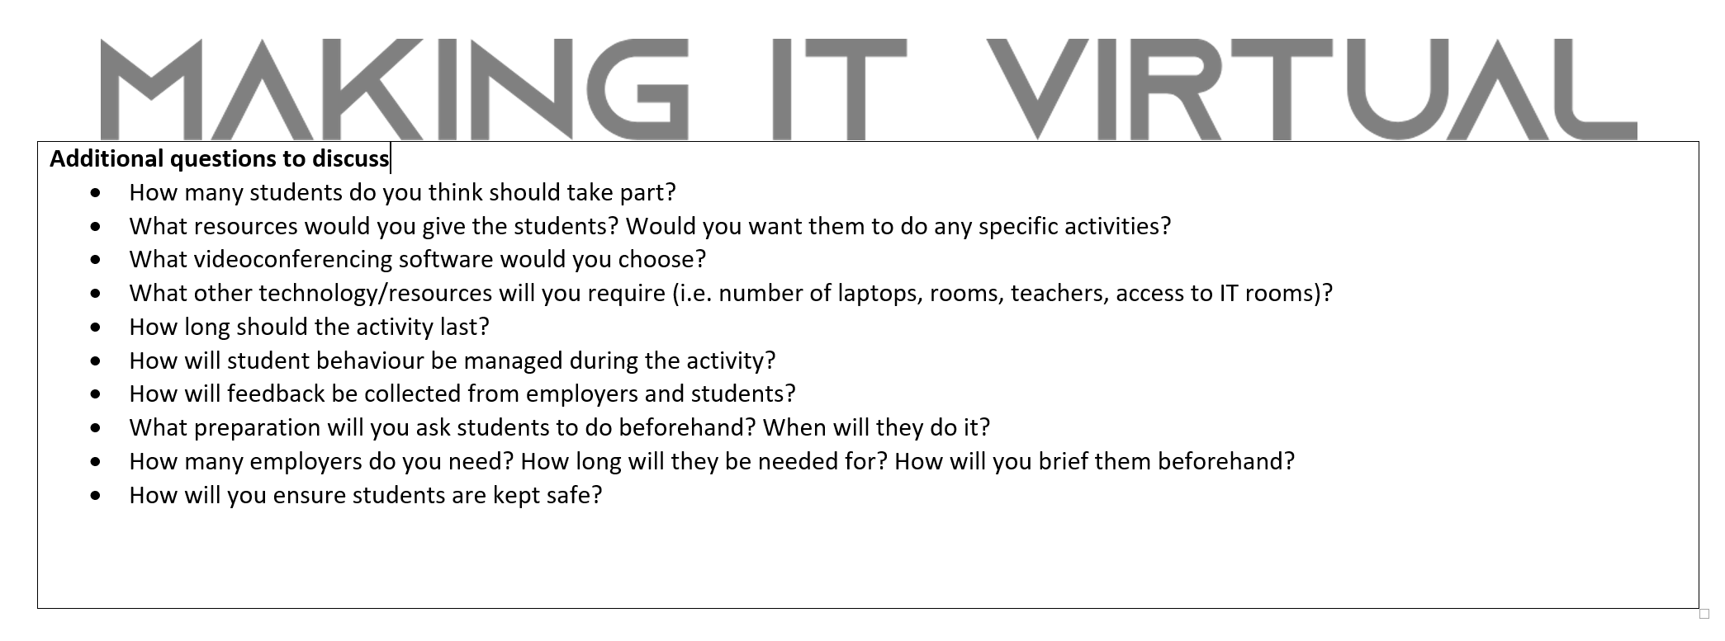
Activity planning sheet (continued)

Slide 15
GB5 Task
Breakout rooms

Slide 16
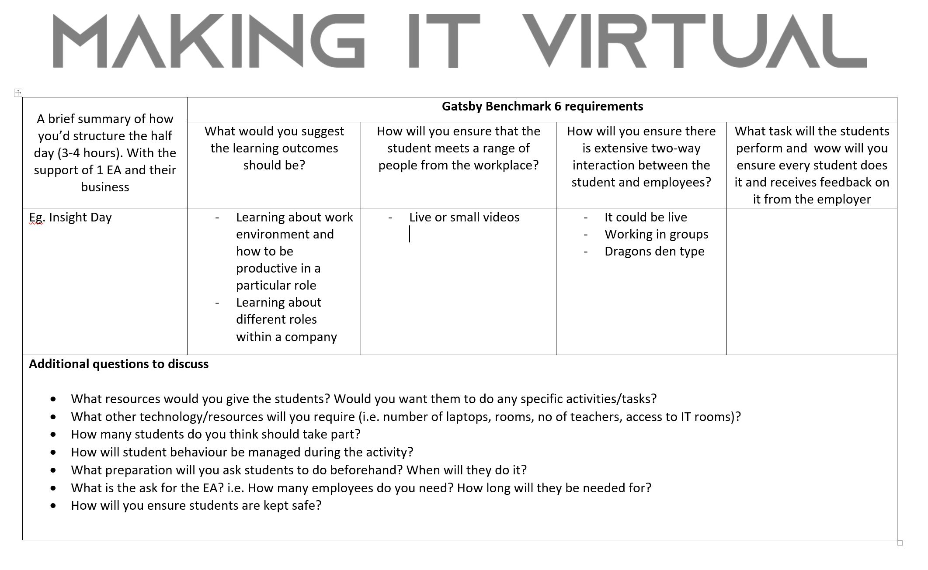
Activity planning sheet (template)
Notes:
https://www.careersandenterprise.co.uk/sites/default/files/uploaded/1207_-_meaningful_encounters_checklist_1.pdf

Slide 17
GB6 Task
Breakout rooms

Slide 18
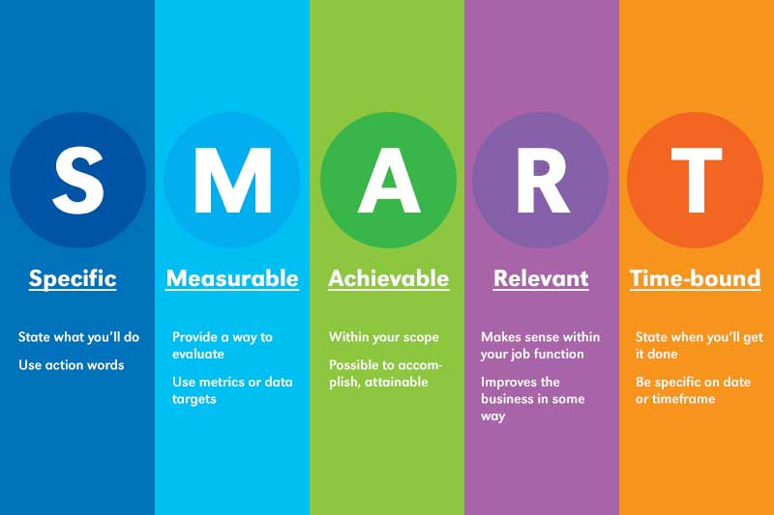
Activity Planning Tips
Make your activity plans relevant, engaging, and productive.
Start with the big picture. I believe that starting is the hardest part. …
Behind every great lesson is a strong learning objective (think SMART)
Let the students know what they will be learning; keep them engaged and on track
Get creative about your resources
Think backwards and relate the activity plan to real life. ...
Think about any questions you might ask the students to keep them engaged (use a poll, a quiz etc.)
Set a time for Q&A
Notes:
https://www.careersandenterprise.co.uk/sites/default/files/uploaded/1207_-_meaningful_encounters_checklist_1.pdf

Slide 19
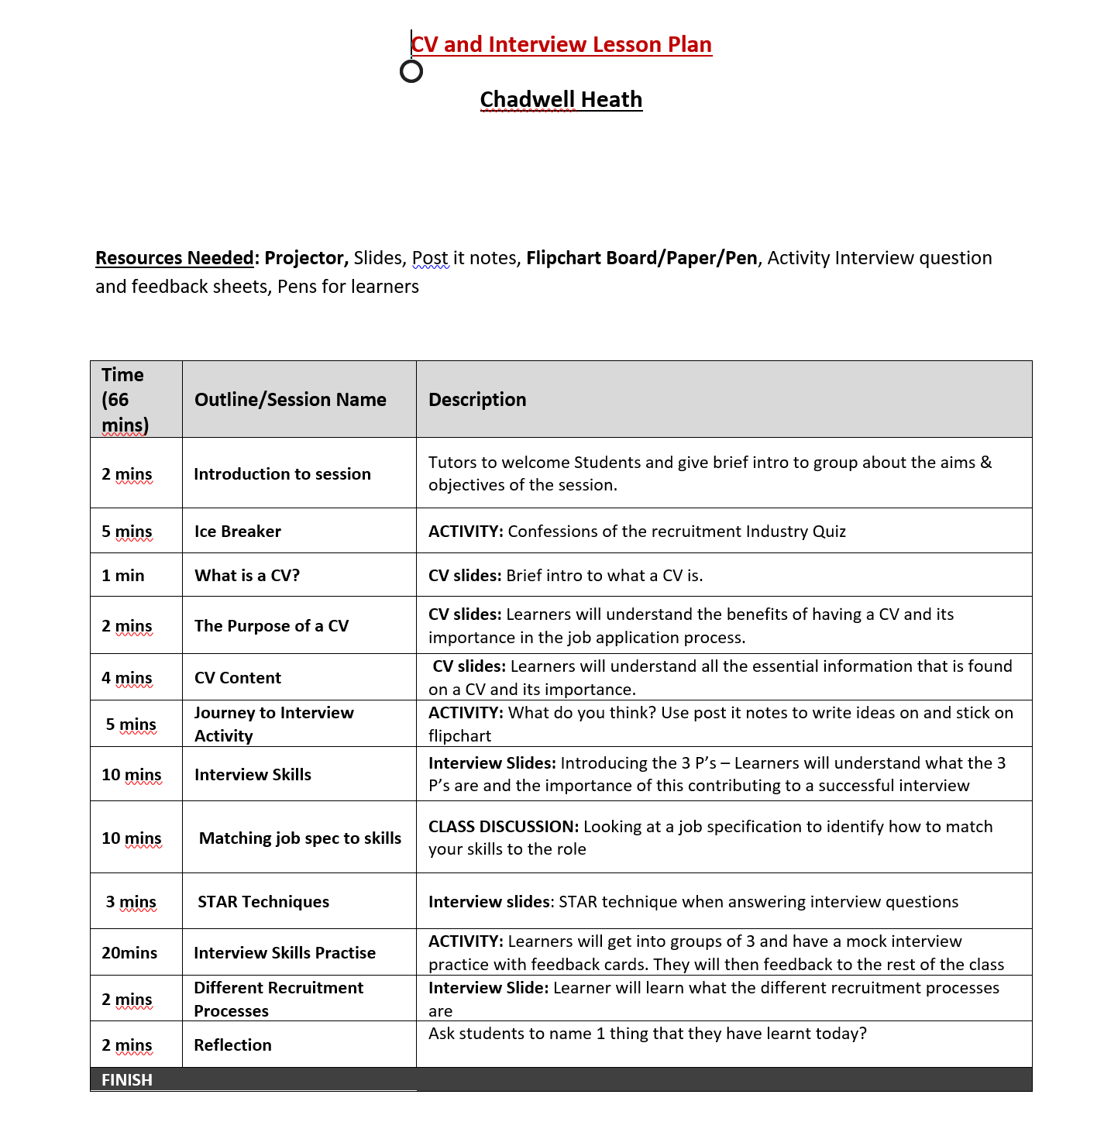

Slide 20
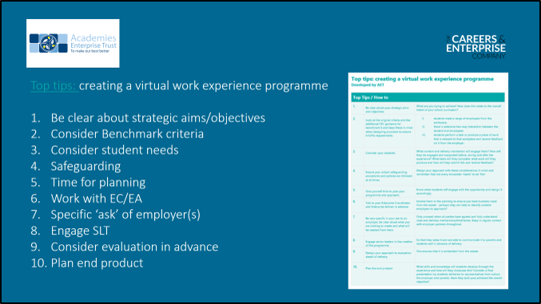

Slide 21
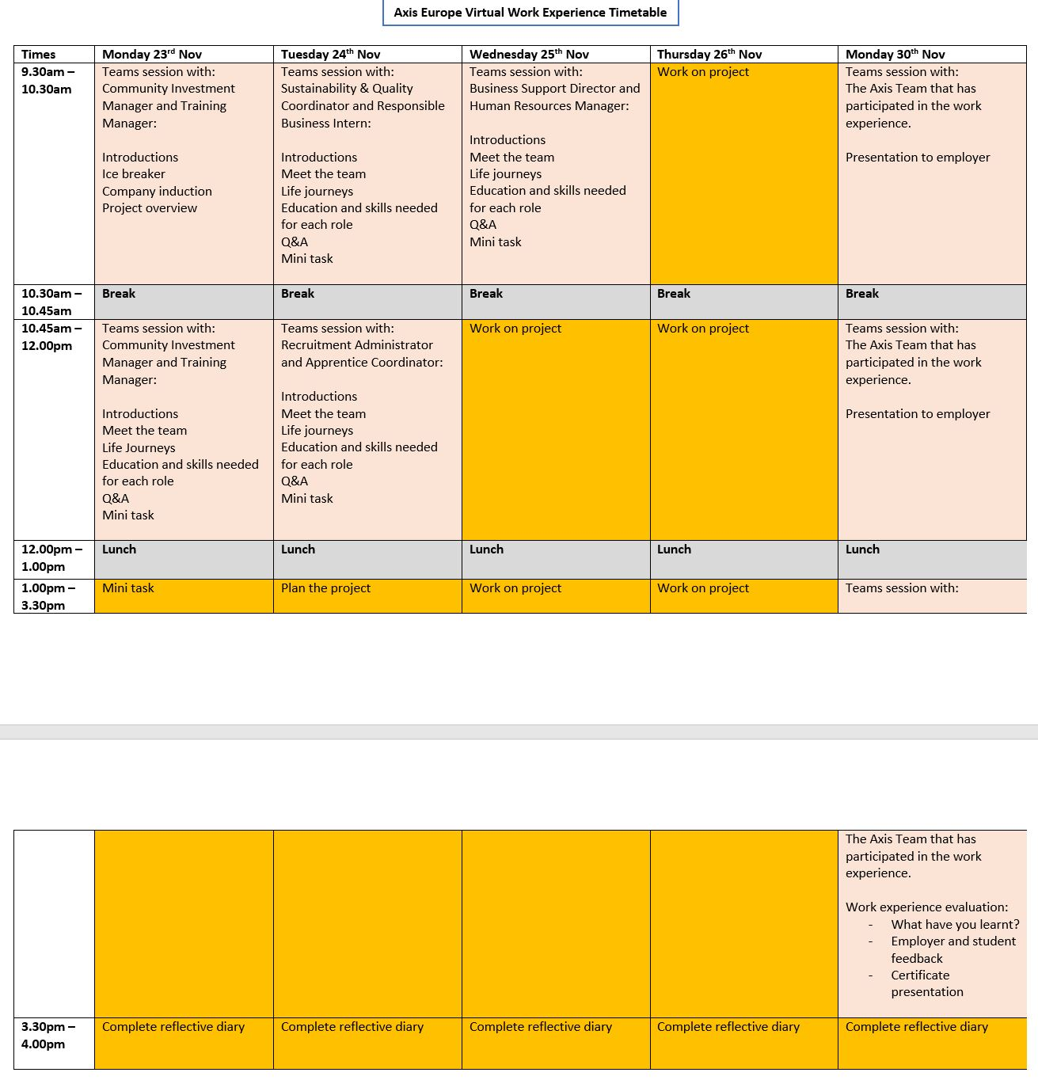

Slide 22
Q&A

