Slide 1



London Enterprise Adviser Network
How to Provide EA Support Virtually
Thursday 22nd October 2020
@CareersHubEast @Local_London1 @CareerEnt

Slide 2
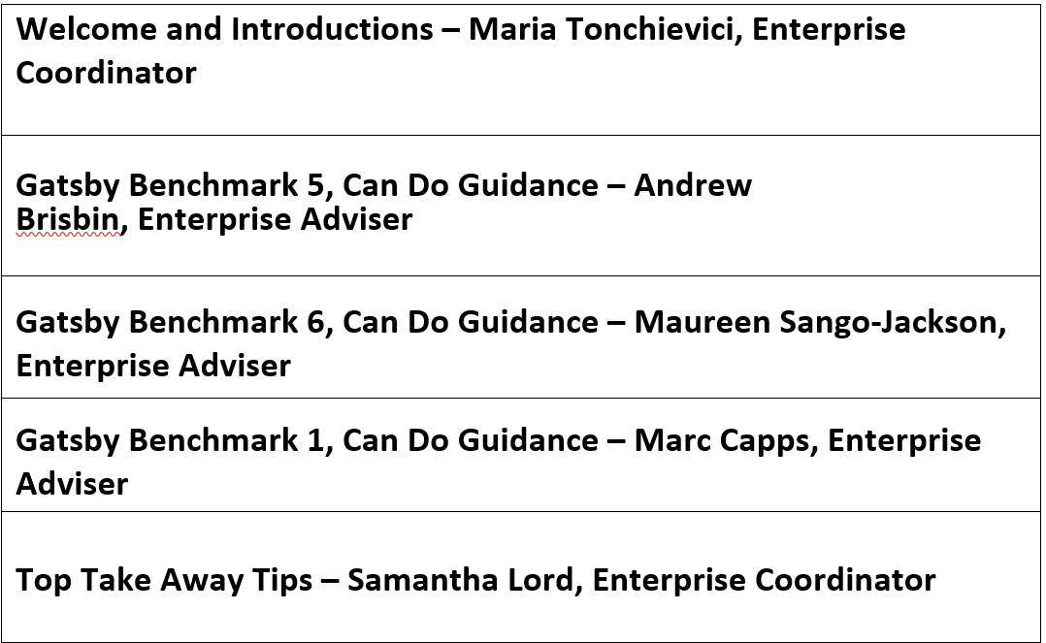
Agenda
Notes:
Recorded session
Q&A session at the end; put your questions in the chat
Snapshots during the session to be shared on social media

Slide 3

Careers in Context:
A can-do guide

Slide 4
Why have we created this guide?
CEC are delighted to launch the new Careers in Context: a can-do guide, developed in collaboration with The Gatsby Foundation.
We know that Covid-19 changed the face of the 2019-20 academic year, with significant additional pressures placed on education leaders and their teams
Increasingly, flexible and creative approaches to careers are required.
The Gatsby Benchmarks have not changed and neither has the expectation that they remain a framework for good career guidance.
Notes:
As we entered the new academic year we can see that the pandemic has changed the value placed on quality careers guidance as part of an institution’s recovery planning, presenting opportunities to achieve impact in new ways.
At the end of last term almost three quarters (72%) of secondary school and college leaders felt that careers guidance had become even more important, although there had been significant disruption to careers programmes over the lockdown.
It is recognised that there are immense and varied pressures on schools and colleges, but the combination of more engaged senior leaders and a student body that needs support shows how important careers guidance is.
“Although Covid-19 presents many challenges, and a few opportunities, the Gatsby Benchmarks remain at the heart of Careers Guidance in England. Their principles are as relevant today as before the pandemic” (Sir John Holman).

Slide 5
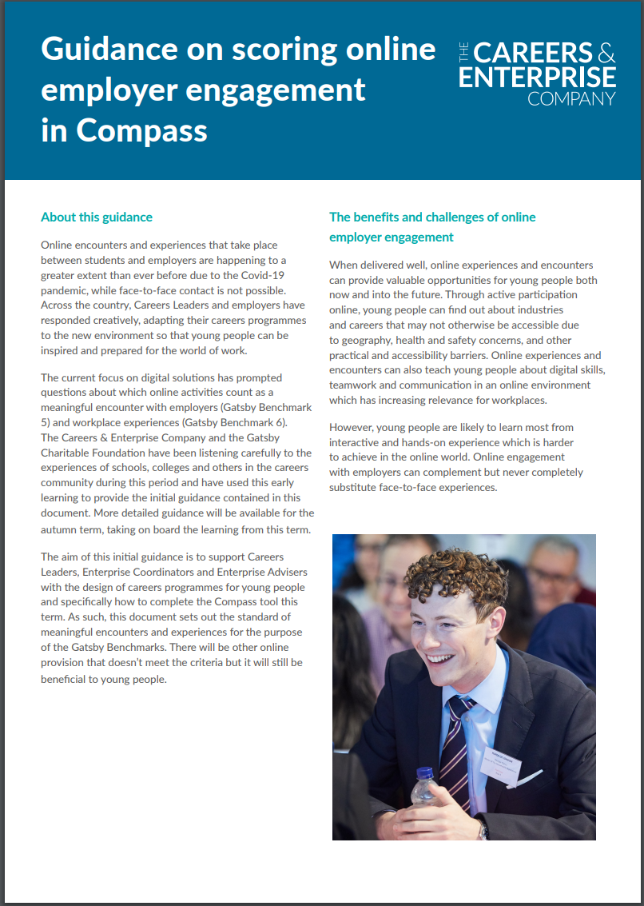
What is the aim of the guide?
To give Careers Leaders confidence and ownership about what they can build into their strategic plans this academic year.
To reinforce that the Gatsby Benchmarks remain a framework for good career guidance.
To build upon an earlier publication about online employer engagements, which can be found here.
Notes:
It is also intended that Enterprise Coordinators, Enterprise Advisers, employers and other organisations will find the information within this guide useful when considering how to adapt the design and delivery of careers programmes in a way that continues to meet the needs of young people.

Slide 6
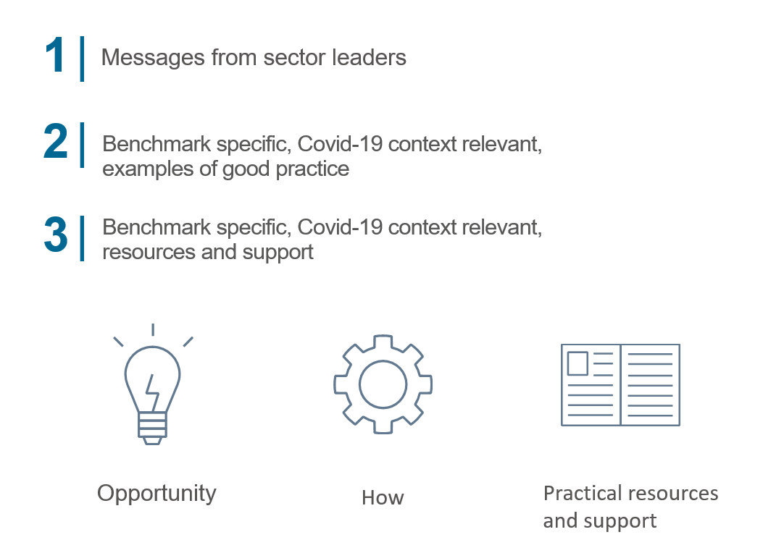
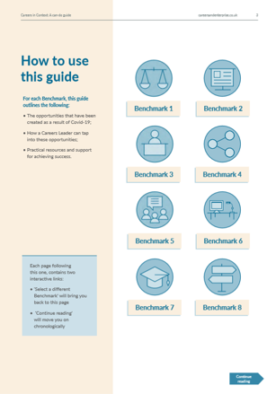
What does the guide include?
Notes:
This guide highlights quality resources and innovative worked examples, showcasing how practice can be adapted to meaningfully meet the needs of students, whilst continuing to meet the benchmarks.
Change brings opportunity.
Quick Reminder: The Making it Meaningful Framework is designed to help Careers Leaders ensure each encounter or experience is meaningful for all participants and will ensure quality and consistency to activity. This guide gives examples that apply the framework, to maximise the opportunity and impact of blended, online and face to face encounters and experiences.

Slide 7
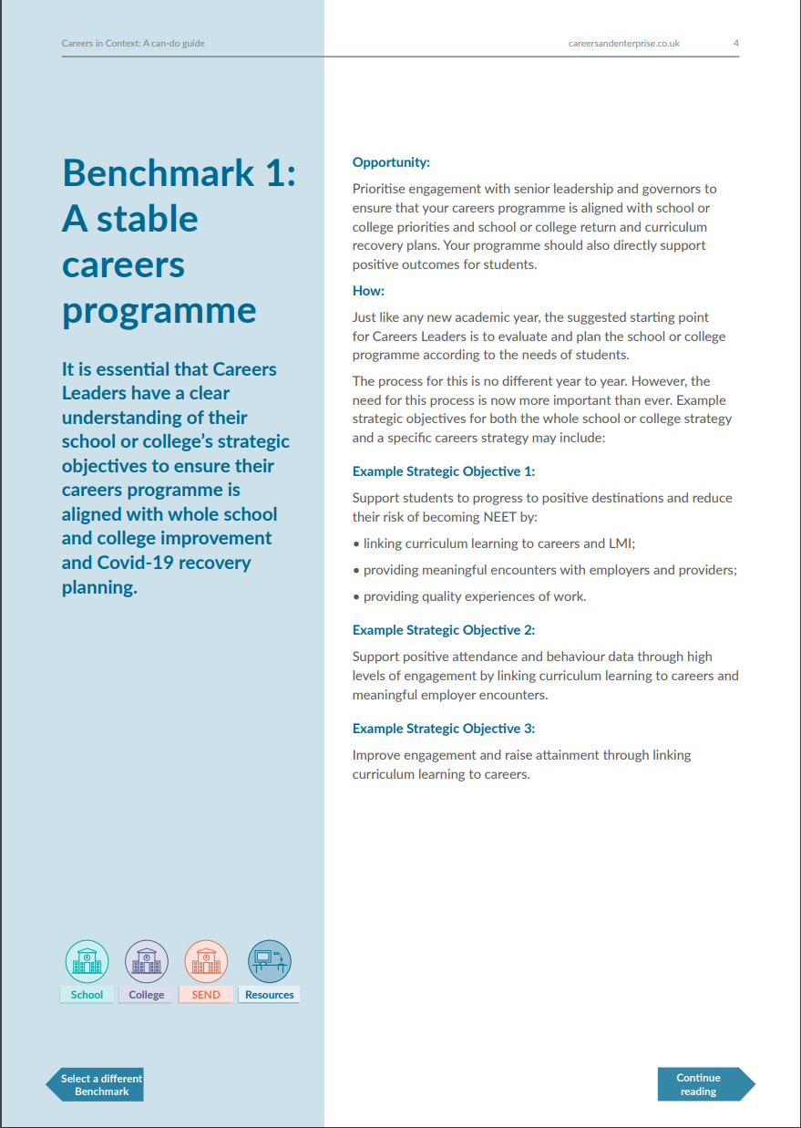
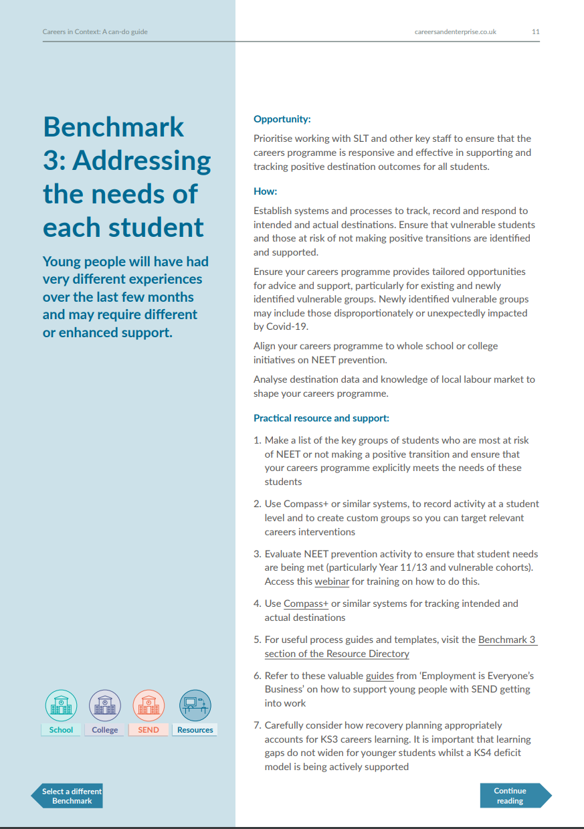
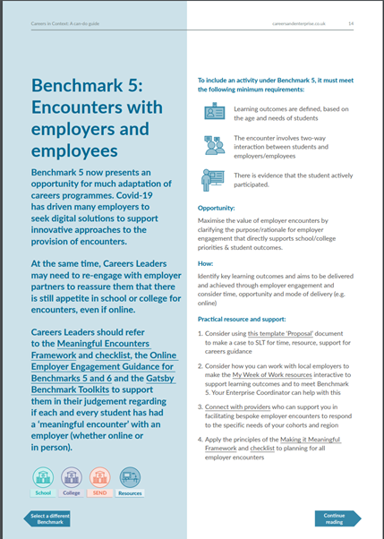

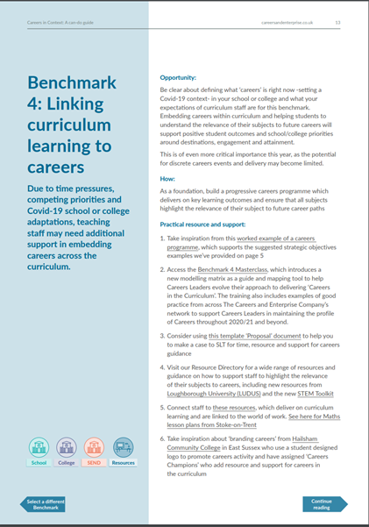
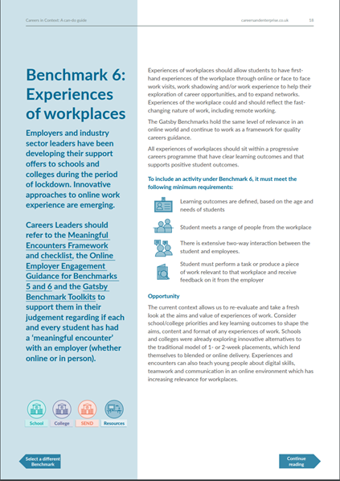

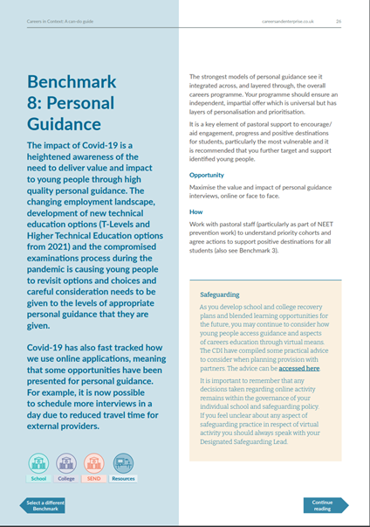
Benchmark by Benchmark
Notes:
Follow up email with the Can do guide and next steps
For each Benchmark, this guide outlines:
• The opportunities that have been created as a result of Covid-19;
• How a Careers Leader can tap into these opportunities;
• Practical resources and support for achieving success.

Slide 8
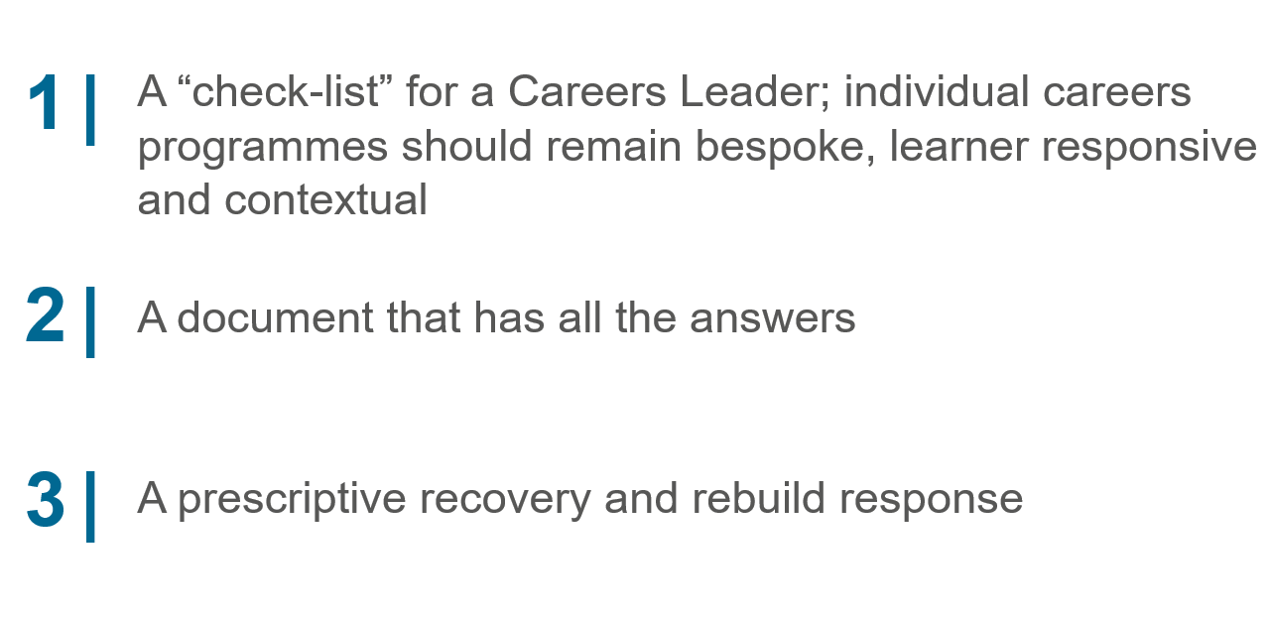
What this guide is NOT

Slide 9
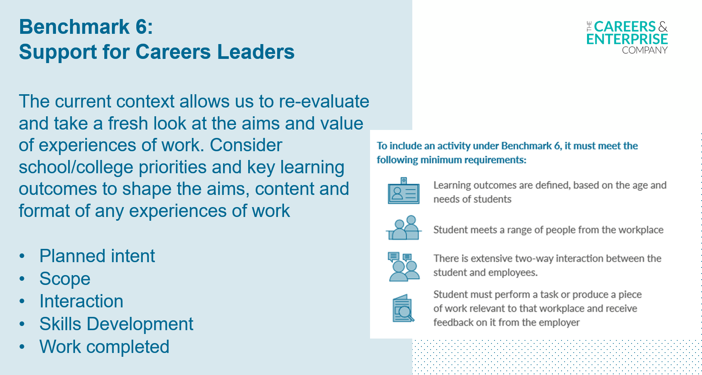
Focus for LEAN – Gatsby Benchmarks 1, 5&6
Notes:
Experiences of workplaces should allow students to have firsthand experiences of the workplace through online or face to face work visits, work shadowing and/or work experience to help their exploration of career opportunities, and to expand networks. Experiences of the workplace could and should reflect the fastchanging nature of work, including remote working.
All experiences of workplaces should sit within a progressive careers programme that have clear learning outcomes and that supports positive student outcomes.
Across the country, Careers Leaders and employers have responded creatively, adapting their careers programmes to the new environment so that young people can be inspired and prepared for the world of work. When delivered well, online experiences and encounters can provide valuable opportunities for young people both now and into the future. Through active participation online, young people can find out about industries and careers that may not otherwise be accessible due to geography, health and safety concerns, and other practical and accessibility barriers. Online experiences and encounters can also teach young people about digital skills, teamwork and communication in an online environment which has increasing relevance for workplaces. However, young people are likely to learn most from interactive and hands-on experience which is harder to achieve in the online world. Online engagement with employers can complement but never completely substitute face-to-face experiences.

Slide 10
Gatsby Benchmark 6 - Can Do Guidance
Maureen Sango-Jackson
Enterprise Adviser

Slide 11
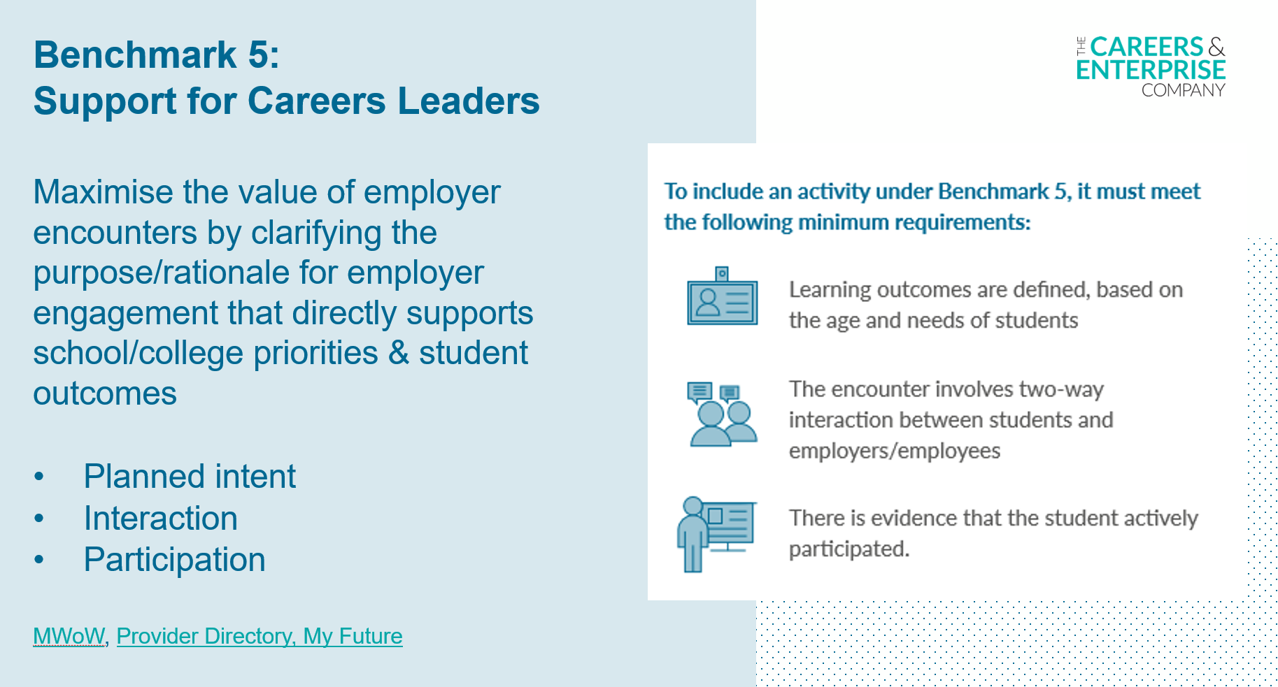
Focus for LEAN – Gatsby Benchmarks 1, 5&6
Notes:
The current focus on digital solutions has prompted questions about which online activities count as a meaningful encounter with employers (Gatsby Benchmark 5) and workplace experiences (Gatsby Benchmark 6).
Benchmark 5 now presents an opportunity for much adaptation of careers programmes. Covid-19 has driven many employers to seek digital solutions to support innovative approaches to the provision of encounters.

Slide 12
Gatsby Benchmark 5 - Can Do Guidance
Andrew Brisbin
Enterprise Adviser

Slide 13
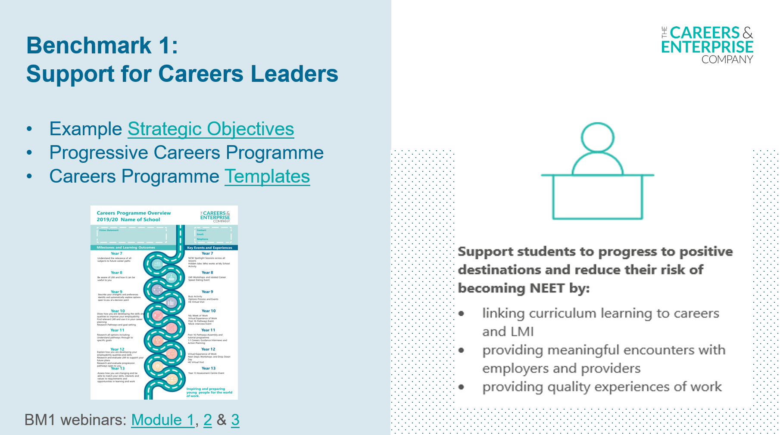
Focus for LEAN – Gatsby Benchmarks 1, 5&6
Notes:
It is essential that Careers Leaders have a clear understanding of their school or college’s strategic objectives to ensure their careers programme is aligned with whole school and college improvement and Covid-19 recovery planning.
Prioritise engagement with senior leadership and governors to ensure that the careers programme is aligned with whole school and college improvement and Covid-19 recovery planning. The programme should also directly support positive outcomes for students.

Slide 14
Gatsby Benchmark 1 - Can Do Guidance
Marc Capps
Enterprise Adviser

Slide 15
Top Tips &
Useful Resources

Slide 16
Top Tips
Encourage your CLs to sign up for one of our funded bursaries.
Ask your EC what's happening virtually in their other schools/colleges, then replicate that in your school/college.
Encourage your CL’s to register and use ‘My Week of Work’ in their careers programme.
Allow students to observe live or record your staff meetings or do a virtual tour of your office for students interested in your industry.
Keep engaging with your school.
Share up-to-date Local market information about the opportunities available in your organisation.
Link your careers activities to the curriculum to make them stick.
Work with your school to identify the cohorts and students most in need of support.
Use the resource available to you on our website.
Use our ‘Find an Activity Provider’ if you need expert support from another industry in your school/college.
Notes:
Following an initial 1300 training places taken up, we have a further 650 places available.
What to expect
You can gain access to a qualification (up to level 7)
You will be able to choose a programme that suits your time commitment
There are both non-accredited and accredited programmes available
You will be able to find a programme that’s local to you
There are a variety of programmes which cover different development areas of the Careers Leader role
There will be the opportunity to meet and network with other Careers Leaders
Upon completion of the course, your school or college will be awarded a £1,000 bursary to cover any costs incurred attending the training

Slide 17
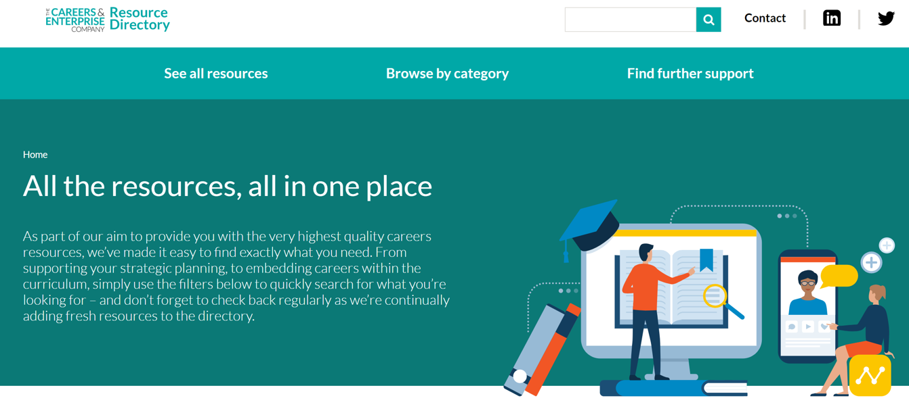
The CEC Resource Directory
Notes:
RF

Slide 18
Careers Leader Bursaries
650 further places available for Careers Leader training.
Accessed now via The Careers & Enterprise Company website or here.
All training providers offering virtual delivery of their courses in response to the impact of Covid-19.
Schools and colleges may apply for more than one place as long as the individual attending is a named Careers leader/overseeing Careers activity.
Download Careers Leader Training Catalogue
If you have any questions about the training please contact careersleaders@careersandenterprise.co.uk
Notes:
Following an initial 1300 training places taken up, we have a further 650 places available.
What to expect
You can gain access to a qualification (up to level 7)
You will be able to choose a programme that suits your time commitment
There are both non-accredited and accredited programmes available
You will be able to find a programme that’s local to you
There are a variety of programmes which cover different development areas of the Careers Leader role
There will be the opportunity to meet and network with other Careers Leaders
Upon completion of the course, your school or college will be awarded a £1,000 bursary to cover any costs incurred attending the training

Slide 19
Q&A

