Slide 1


The London Enterprise Adviser Network
LEARN.EXPERIENCE.ADVICE.NETWORK
NORTH EAST BOROUGHS
Delivered in East London by Local London ELBA (LEANEast)
#EANetwork @TeamLdn @CareerEnt @LEANEastLondon

Slide 2
AGENDA
Welcome & Housekeeping
Careers Hubs
Compass review & Next academic year (2021/2022)
Give an Hour (and other updates)
Guest Speaker - Danielle Ferguson EA (The Money & Marketing Manager)
EA Discussion Forum

Slide 3
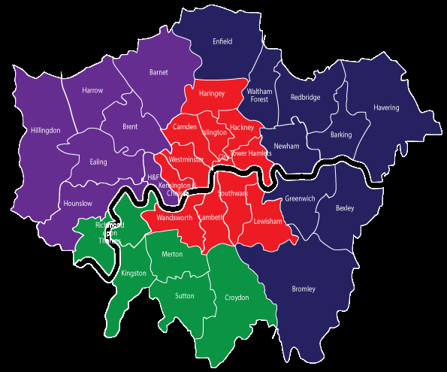
Four Careers Hubs, one per sub region
Each Careers Hub to engage secondary schools, FE colleges, APs, and special schools
Align Hub with borough, sub regional, London and national priorities
Each hub have a focus on supporting SME’s to engage with schools and colleges
Dedicated funding to support SMEs to deliver BM5 & 6 activities
Dedicated support for SMEs to work with YP with SEND

Slide 4
A Careers Hub provides…
Enhanced delivery model of the current London Enterprise Adviser Network
Strong local leadership and coordination of careers provision
Enterprise Coordinators have more time dedicated to each school/college
Increased access to careers activities funded directly by the
Careers Hub
Opportunities to test and trial new projects before they are rolled out across the country. Examples include funding for transitions projects and early access to digital platforms
Cornerstone employers committed to supporting schools and
colleges in the Careers Hub
In London we will have four geographical Careers Hubs
Career Hubs : You can watch the recordings of the sessions using this link.

Slide 5
Benefits for Schools/Colleges
More people allows for dedicated support
Strong local leadership from a Strategic Hub lead
Better links to businesses and Cornerstone Employers
Access to national resources, funding and pilots
Access to delivery of careers activities and work insight days
An ability to shape and influence London and national careers policy

Slide 6

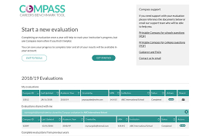
Compass Evaluations
EC’s will be asking CL’s to update their Compass reporting tool before the end of term
Compass captures all activity that has taken place regarding a Schools career programme
Compass identifies performance against each Gatsby benchmark
Supporting information on national performance is also available and supports individual school attainment
Compass assists schools through identifying areas of strength and also areas to work on, like a swot analysis tool
Quick wins can be identified
Longer projects can be planned
Improvements and events can be directly linked and measured
EC’s & EA’s may then support programme direction, method and delivery
Completed regularly (1 per term) completes a picture of attainment for the careers programme for all stakeholders: Governors, SLT, teachers, parents, students, Ofsted
Maintaining completion will give an excellent picture of progress before, during and through recovery from the pandemic and into the future
Please support by reminding gently and questioning supportively
Links to Resources:
EA Useful Links to Resources
CEC / EA Resources
PDF of Compass Questions

Slide 7
RESOURCES
CEC Gatsby Benchmark toolkits for schools, colleges and the new Careers in Context 2020: A Can Do Guide (what constitutes good careers guidance in the context of Covid-19)
https://www.careersandenterprise.co.uk/about-us/our-network/enterprise-adviser-resources
(understanding of the EA role and improving careers provision in schools and colleges)
https://www.careersandenterprise.co.uk/schools-colleges/my-choices-transition-resources Resources to support CLs in helping young people as they prepare for their next stages Post 16. ‘on-demand’ virtual event where young people can hear directly from employers and apprenticeship providers about the opportunities available to them. This is available to access now.

Slide 8
EA Survey
EA + CL LEAN End of Academic year survey - Deadline for completions - End of term
We know that we have a lot of EA’s and CL’s that have really valued the support we’ve provided this year – this is our chance to capture evidence of it! The forms are for EA’s and CLs
EA Survey shareable link: https://forms.office.com/Pages/ResponsePage.aspx?id=6j1lMAH7TEuN38GD-J_r-9OlgTMF8YVCrb0-88DWxghUNlJGTDc2Nlg4Tko1SDhVTEtTNVlZODBYNS4u

Slide 9
Give an hour campaign

Slide 10
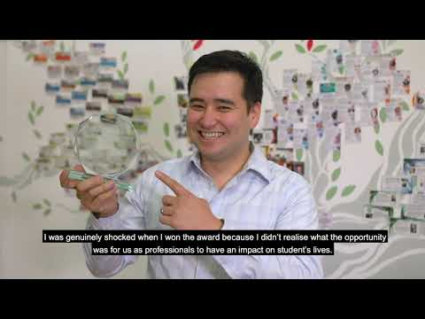

LEAN 2020 Awards Celebration Video

Slide 11
LEAN CELEBRATION REMINDER
Q&As?
Email: leaneast@elba-1.org.uk

Slide 12
GUEST SPEAKER & EA DISCUSSION FORUM
DANIELLE FERGUSON EA (THE MONEY AND PENSIONS COMPANY)

